Slide 1
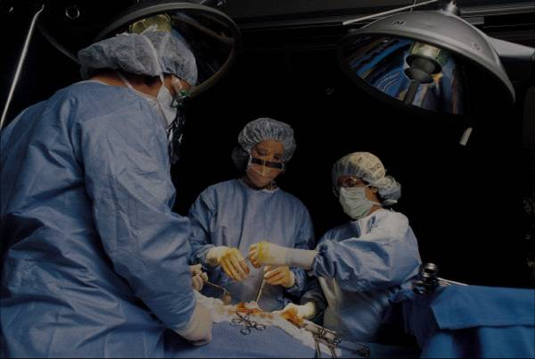
19th International Multiple Sclerosis Congress in IRAN
Replace This Text With Your Title
Arian Oladzad, MD¹; Arian Oladzad, PhD²; Arian Oladzad, MD, PhD^{1,2}
¹University of Affiliation, ²Medical Center of Affiliation
Abstract
Methods and Materials
Chart 1. Label in 14pt Calibri.
Introduction
Results
Discussion
Conclusions
Table 1. Label in 14pt Calibri.
 | Heading | Heading | Heading
Item | 800 | 790 | 4001
Item | 356 | 856 | 290
Item | 228 | 134 | 238
Item | 954 | 875 | 976
Item | 324 | 325 | 301
Item | 199 | 137 | 186
Figure 1. Label in 14pt Calibri.
Figure 2. Label in 14pt Calibri.
Contact
References
<your name>
<your organization>
Email:
Website:
Phone:

